Slide 1
Web Design &Development
Using Cascading Style Sheets (CSS)
continued

Slide 2
Selector Type
Tag
  redefines the look of a specific tag
  E.g. body {background-color: #000000;}
Class
  can apply to any tag
  E.g. .indent{margin-right:5%;margin-left: 5%;}
  In HTML, <p class=“indent”>
Advanced
  IDs, pseudo-class selectors
  E.g. #myId {color: #38608A;}
Notes:
pseudo-classes are used in CSS selectors to allow information external to the HTML source (e.g. the fact that an anchor has been visited or not) to classify elements.

Slide 3
Values - Lenghts
Lengths [a number + unit identifier]
  Unit identifier can be
  em (font size of the relevant font),
  ex (x-height of the relevant font),
  px (pixels),
  in (inches), cm (centimeter), mm,
  pt (points, =1/72 in), pc (picas, 1 pc = 12 pt)
  E.g.
  h1 { margin: 0.5em }, h1 { margin: 1ex },
  p { font-size: 12px }, h2 { line-height: 3cm }, h4 { font-size: 12pt }, h4 { font-size: 1pc }

Slide 4
Values – Percentages & URIs
Percentages [a number + %]
  p { line-height: 120% }
URLs & URIs
  url(“<A URI/URL>”), or
  url(<A URI/URL>)
  li { list-style: url(http://www.cs.pitt.edu/~mehmud/image/bullet2.jpg) disc }
  body { background: url("yellow.png") }
  where, “yellow” is relative to the URI of the style sheet.

Slide 5
Values - Colors
Colors
  A color is either a keyword (e.g. white, red), or a numerical RGB specification (e.g. ).
A numerical RGB specification can be:
  An RGB value in hexadecimal notation, which is a ‘#’ immediately followed by a 6 digit or 3 digit hexadecimal number, i.e.
  #rrggbb or #rgb.
  E.g. #ff0000, #f00
  An RGB value in functional notation, i.e.
  rgb(rrr,ggg,bbb), rgb(r%,g%,b%)
  E.g. rgb(255,0,0), rgb(100%,0%,0%)

Slide 6
Values - Colors
16 original predefined color codes (names)
216 browser safe colors
  Colors display correctly on all color monitors

Slide 7
Values - Strings
String
  Sequence of characters written inside double quotes ("") or single quotes ('').
Examples
"this is a ’string’“
"this is a \"string\"“
’this is a "string"’
’this is a \’string\’’

Slide 8
Box Properties
margin : <length>
border : <style> <width> <color>
padding : <length>
width & height : <length>
Examples:
p{
margin: 50px;
padding: 30px;
float: right;
height: 200px;
width: 400px;
border: 5px solid #006633;
}

Slide 9
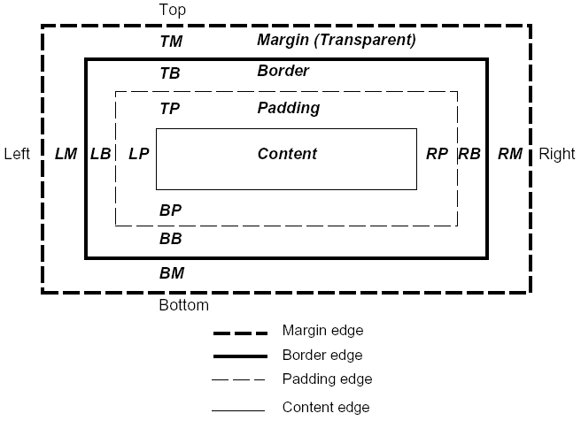
Box Model

Slide 10
Text Properties
font-family : <font name>, | <font name>, …
font-size : <length> | <percentage> | inherit
font-weight : normal | bold | lighter | 100 | 200 ...
  normal = 400, bold = 700, lighter is relative
font-style : normal | italic | oblique | inherit
line-height : normal | <length> | <percentage> | inherit
text-transform : capitalize | uppercase | lowercase | none | inherit
color : <color>
text-indent : <length> | <percentage> | inherit
text-align : left | right | center | justify | inherit

Slide 11
Text Properties Practice
Practice
  Create a paragraph text
  Create internal style for <p> tag as following
  Create a internal style called “textStyle” and apply it to paragraph text and let it look like this
p{
margin: 50px;
padding: 50px;
clear: right;
float: right;
border: 10px solid #0066CC;
}

Slide 12
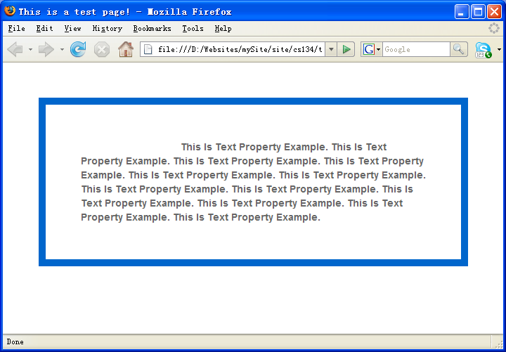
Text Properties Practice
Color is #666666; font-family is Arial, Helvetica, sans-serif; font-indent is 20%;

Slide 13
Positioning Properties
height : <length> | <percentage> | inherit
width : <length> | <percentage> | inherit
left : <length> | <percentage> | auto | inherit
top : <length> | <percentage> | auto | inherit
right : <length> | <percentage> | auto | inherit
bottom : <length> | <percentage> | auto | inherit
position : static | relative | absolute | fixed | inherit
left/top/right/bottom usually used when position is specified as absolute.

Slide 14
Values for position property
Value | Description
static | Default. An element with position: static always has the position the normal flow of the page gives it (a static element ignores any top, bottom, left, or right declarations)
relative | An element with position: relative moves an element relative to its normal position, so "left:20" adds 20 pixels to the element's LEFT position
absolute | An element with position: absolute is positioned at the specified coordinates relative to its containing block. The element's position is specified with the "left", "top", "right", and "bottom" properties
fixed | An element with position: fixed is positioned at the specified coordinates relative to the browser window. The element's position is specified with the "left", "top", "right", and "bottom" properties. The element remains at that position regardless of scrolling. Works in IE7 (strict mode)

Slide 15
Positioning Properties
A floated box is shifted to the left or right until its outer edge touches the containing block edge or the outer edge of another float.
Example
.positionStyle {
height: 400px;
width: 200px;
left: 50px;
top: 50px;
right: 50px;
bottom: 50px;
position:absolute;
float: rigth;
}

Slide 16
List Properties
list-style: [disc | circle | square | decimal | lower-roman | upper-roman | lower-alpha | upper-alpha | none] || [inside | outside] || [<url> | none]
  Example
  li { list-style: url(/bullet2.jpg) disc inside; }
Can use the list-style-type, list-style-image, list-style-position separately.

Slide 17
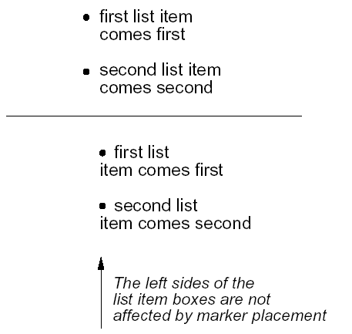
List Properties
Difference between inside and outside
Outside

Slide 18
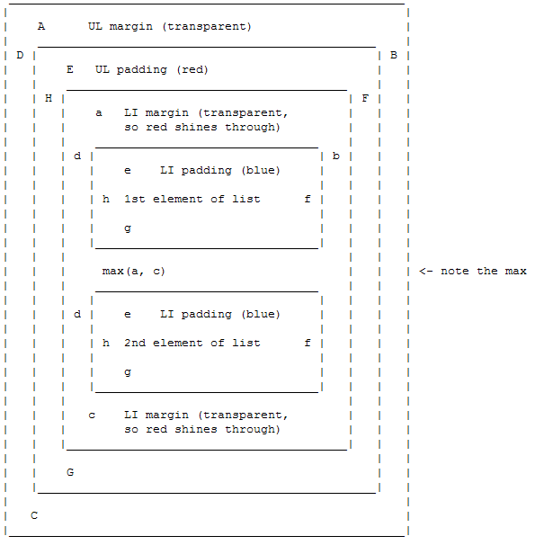
Box Model for List

Slide 19
Background Properties
background-color: <color> | transparent | inherit
background-image: <uri> | none | inherit
background-position: [ [ <percentage> | <length> | left | center | right ] [<percentage> | <length> | top | center | bottom ]? ] | [ [ left | center | right ] || [ top | center | bottom ] ] | inherit
background-repeat: repeat | repeat-x | repeat-y | no-repeat | inherit
background-attachment: scroll | fixed | inherit

Slide 20
Background Properties
Practice
body {
background-image: url(image/bgd.png);
background-repeat:no-repeat;
color: #FFFFFF;
background-position:center center;
background-color: #666666;
background-attachment: fixed;
}

Slide 21
<div> and <span> tags
<div>
  is a generic block-level tag
<span>
  is a generic inline tag, it spans a series of characters
Example
.subTitle {
font-family: Georgia, Times, serif;
font-size: 14px; font-weight: bold; color: #960000;
}
<p>blah blah blah <span class="subTitle">some text in different style</span> text text text text</p>

Slide 22
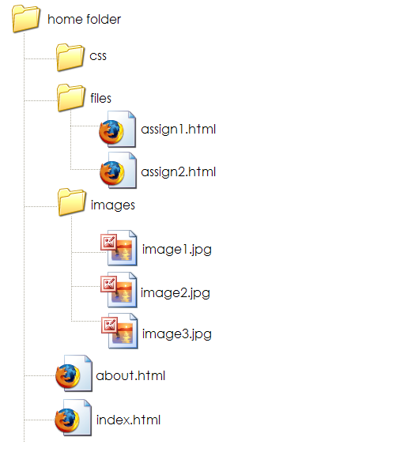
Directory Structure

